Slide 1

FINTRUST BANK ANALYSIS
BY ABHIJEET SINGH PARIHAR

Slide 2

Business Problem
FinTrust Bank is a fictional banking institution created for this portfolio project.
Provides loan products to individual customers.
Loan applications come from customers with different financial and credit profiles.
The business needs to understand which factors are associated with different approval outcomes.
The overall approval rate does not explain why some applications are approved while others are not.

Slide 3

Scope & Objective
Analyze 30,000 loan applications.
Examine factors related to loan approval outcomes.
Analyze credit score, DTI, loan amount, employment type, education, and previous defaults.
Identify patterns across different applicant segments.
Create an exploratory credit-risk segmentation.
Generate business insights and recommendations to support loan-approval analysis.

Slide 4

Data & Tools
Dataset: Historical loan application data
Data: Applicant demographics, income, credit score, DTI, loan amount, loan purpose, employment and approval status
Excel: Data cleaning and Preparation
PostgreSQL: SQL Analysis
Power BI: Dashboard and Data visualization
Microsoft Word: Project Documentation
Microsoft PowerPoint: Project Presentation
GitHub: Project portfolio and File storage

Slide 5
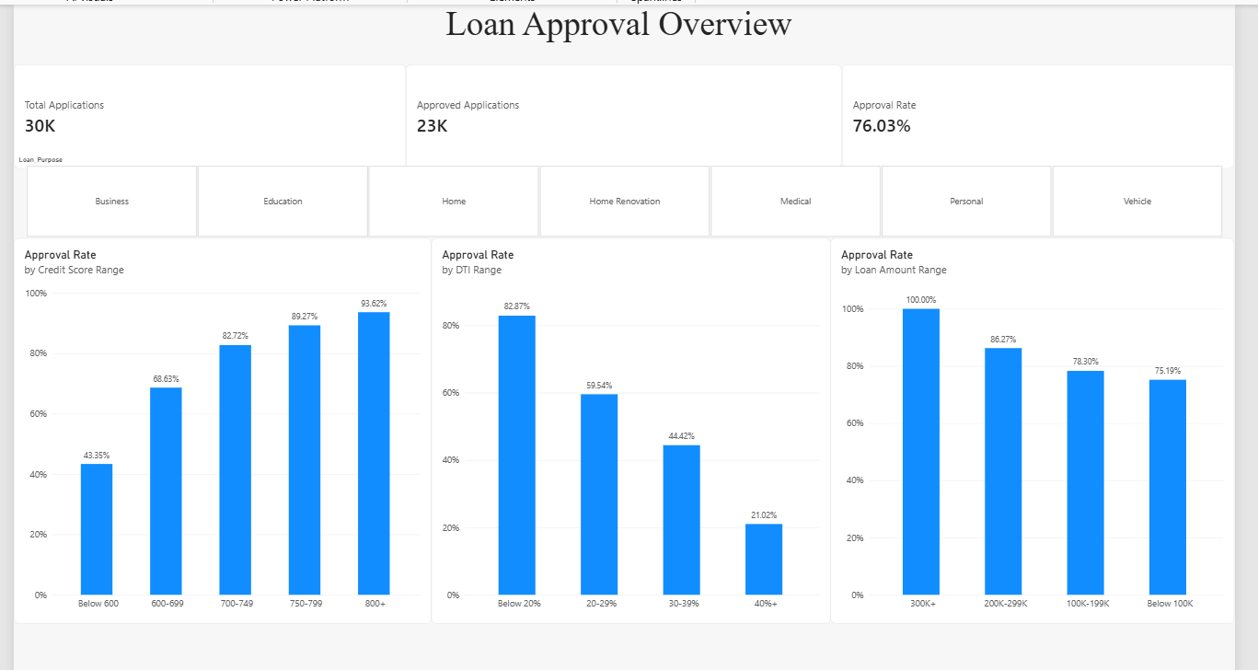
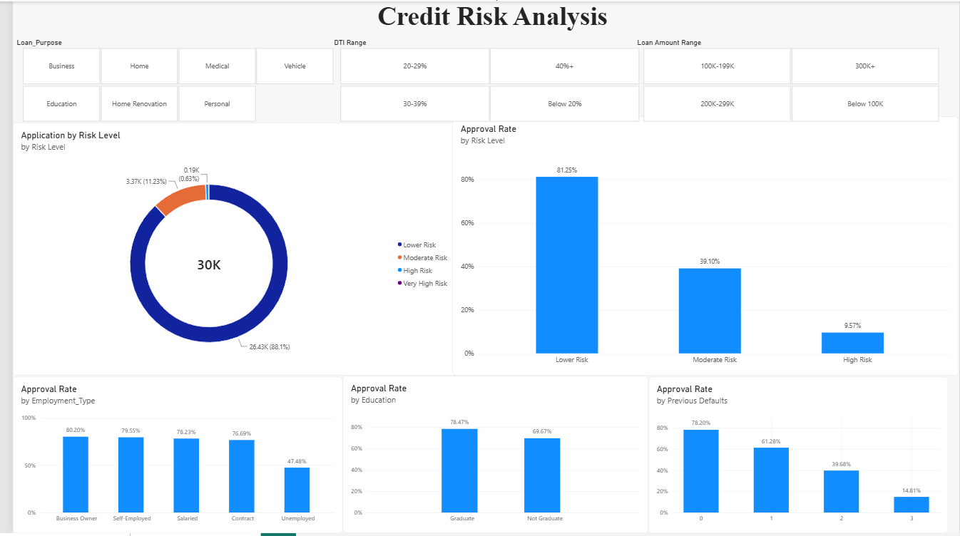
Dashboard

Slide 6

KEY Findings
Credit Score: Approval rate increases substantially across the credit-score ranges, indicating a strong association between stronger credit profiles and approval outcomes in this dataset.
Debt-to-Income Ratio: Approval rate decreases as DTI increases, making debt burden an important segment for credit-risk review.
Loan Amount: Approval rate varies across loan-amount ranges, suggesting requested loan size is associated with different approval outcomes.
Previous Defaults: Approval rate falls sharply as previous defaults increase: approximately 78.20% for 0 defaults, 61.28% for 1, 39.68% for 2, and 14.81% for 3.
Employment Type: Unemployed applicants show a substantially lower approval rate i.e 47.48% than the other listed employment groups, which range from about 76.69% to 80.20%.
Education: Graduates show a higher approval rate than non-graduates: 78.47% versus 69.67%. This is an observed association, not proof of causation.

Slide 7
Recommendations
Use
Use credit score and DTI as early screening indicators — Segments with weaker credit scores and higher DTI show lower approval rates and warrant closer review.
Give
Give greater attention to prior defaults — Multiple previous defaults are strongly associated with lower approval rates in this dataset.
Avoid
Avoid single-factor decisions — Credit score, DTI, loan amount, employment, education, and prior defaults should be evaluated together.
Use
Use interactive segmentation — Business users can filter the dashboard by loan purpose and financial ranges to investigate segments.
Validate
Validate before production use — Any real lending rule would require predictive validation, fairness testing, stability analysis, and compliance review.

Slide 8
Conclusion
The analysis shows clear differences in loan approval rates across credit score, DTI, previous defaults, loan amount, employment type, and education.
Credit score, DTI, and previous defaults show the strongest patterns in approval outcomes.
The Power BI dashboard provides an interactive way to explore these patterns across different applicant segments.
These findings can support further credit-risk review and business decision-making, but they should not be treated as a validated credit-scoring or approval model.

Slide 9
THANK YOU

